Slide 1
Core Cloud Service Categories
Cloud Compute Services
Cloud Networking Services
Cloud Storage Services
Cloud Security, Identity, and Compliance Services
Cloud Analytics Services
Cloud Database Services

Slide 2
Big Data Analytics
in the Cloud

Slide 3
Outline
What is Analytics?
What is Big Data?
Characteristics of Big Data
Domain Specific Examples of Big Data
Analytics Flow for Big Data
Big Data Stack
Mapping Analytics Flow to Big Data Stack
Analytics Patterns

Slide 4
What is Analytics?
Analytics is a broad term that encompasses the processes, technologies, frameworks and algorithms to extract meaningful insights from data.
Raw data in itself does not have a meaning until it is contextualized and processed into useful information.
Analytics is this process of extracting and creating information from raw data by ﬁltering, processing, categorizing, condensing and contextualizing the data.
This information obtained is then organized and structured to infer knowledge about the system and/or its users, its environment, and its operations and progress towards its objectives, thus making the systems smarter and more efficient.

Slide 5
The Seven Giants
The National Research Council has done a characterization of computational tasks for massive data analysis (called the seven “giants").
These computational tasks include:
(1) Basis Statistics,
(2) Generalized N-Body Problems,
(3) Linear Algebraic Computations,
(4) Graph-Theoretic Computations,
(5) Optimization,
(6) Integration
(7) Alignment Problems.
This characterization of computational tasks aims to provide a taxonomy of tasks that have proved to be useful in data analysis and grouping them roughly according to mathematical structure and computational strategy.

Slide 6
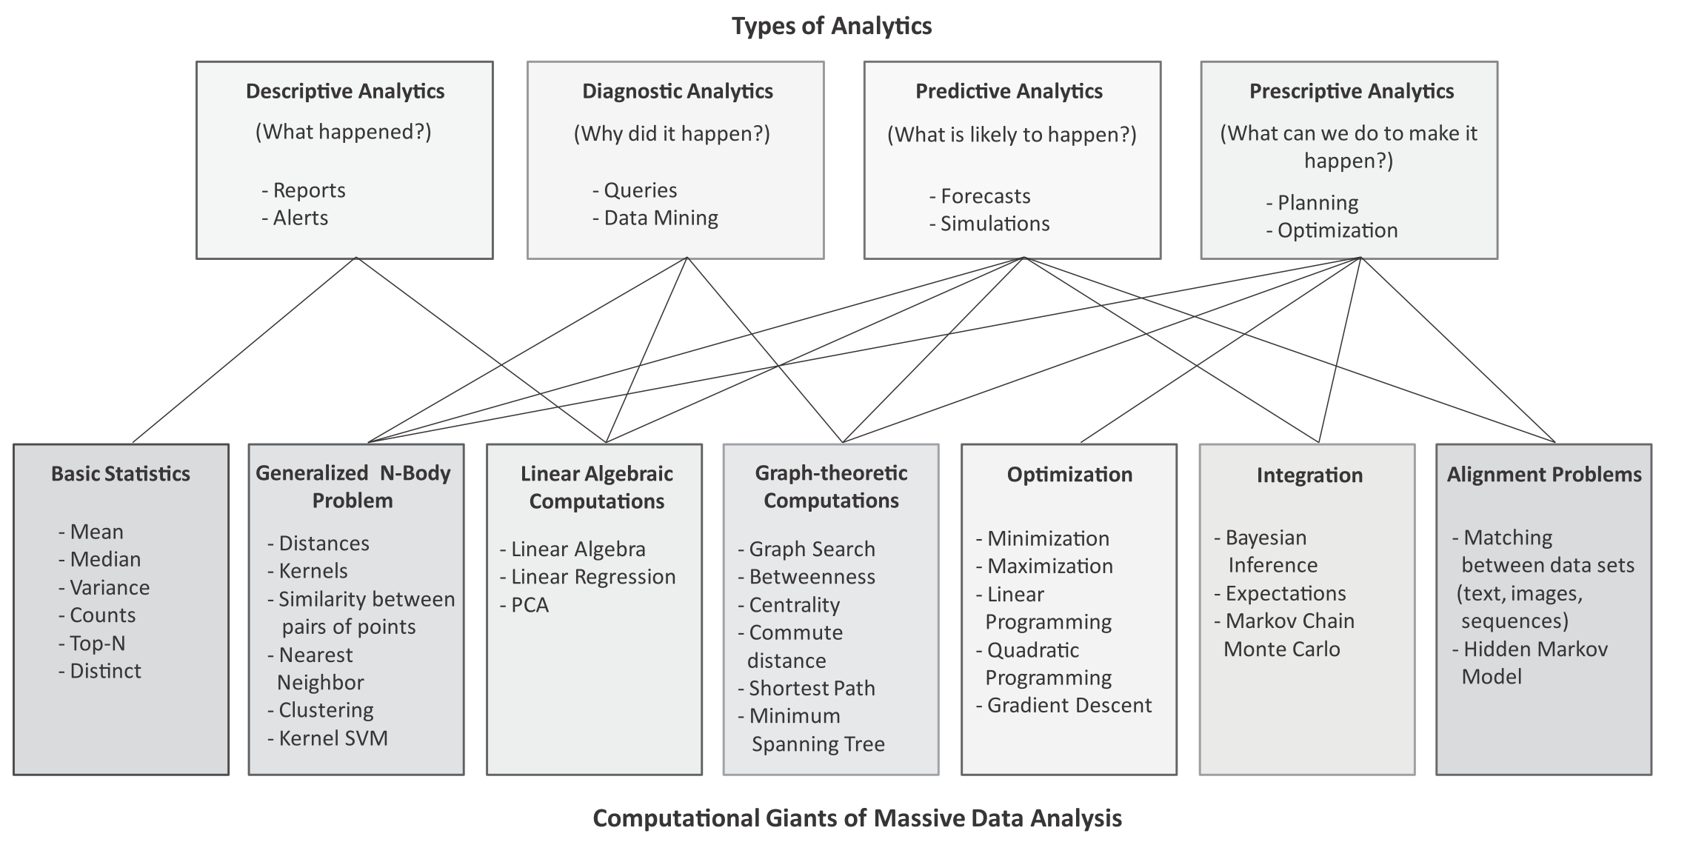
Mapping between types of analytics and computational tasks or ‘giants’

Slide 7
Types of Analytics
Descriptive Analytics
Descriptive analytics comprises analyzing past data to present it in a summarized form which can be easily interpreted. Descriptive analytics aims to answer - What has happened? A major portion of analytics done today is descriptive analytics through use of statistics functions such as counts, maximum, minimum, mean, top-N, percentage, for instance. These statistics help in describing patterns in the data and present the data in a summarized form.
Diagnostic Analytics
Diagnostic analytics comprises analysis of past data to diagnose the reasons as to why certain events happened. Diagnostic analytics aims to answer - Why did it happen? While descriptive analytics can be useful for summarizing the data by computing various statistics (such as mean, minimum, maximum, variance, or top-N), diagnostic analytics can provide more insights into why certain a fault has occurred based on the patterns in the sensor data for previous faults.

Slide 8
Types of Analytics
Predictive Analytics
Predictive analytics comprises predicting the occurrence of an event or the likely outcome of an event or forecasting the future values using prediction models. Predictive analytics aims to answer - What is likely to happen? Predictive Analytics is done using predictive models which are trained by existing data. These models learn patterns and trends from the existing data and predict the occurrence of an event or the likely outcome of an event (classiﬁcation models) or forecast numbers (regression models).
Prescriptive Analytics
While predictive analytics uses prediction models to predict the likely outcome of an event, prescriptive analytics uses multiple prediction models to predict various outcomes and the best course of action for each outcome. Prescriptive analytics aims to answer - What can we do to make it happen? Prescriptive Analytics can predict the possible outcomes based on the current choice of actions.

Slide 9
What is Big Data?
Big data is deﬁned as collections of datasets whose volume, velocity or variety is so large that it is difﬁcult to store, manage, process and analyze the data using traditional databases and data processing tools.
According to an estimate by IBM, 2.5 quintillion bytes of data is created every day.
A recent report by DOMO estimates the amount of data generated every minute on popular online platforms. Below are some key pieces of data from the report:
Facebook users share nearly 4.16 million pieces of content
Twitter users send nearly 300,000 tweets
Instagram users like nearly 1.73 million photos
YouTube users upload 300 hours of new video content
Apple users download nearly 51,000 apps
Skype users make nearly 110,000 new calls
Amazon receives 4300 new visitors
Uber passengers take 694 rides
Netﬂix subscribers stream nearly 77,000 hours of video

Slide 10
Big Data Analytics
Big Data analytics deals with collection, storage, processing and analysis of this massive-scale data.
Big data analytics involves several steps starting from data cleansing, data munging (or wrangling), data processing and visualization.
Specialized tools and frameworks are required for big data analysis when:
the volume of data involved is so large that it is difﬁcult to store, process and analyze data on a single machine,
the velocity of data is very high and the data needs to be analyzed in real-time,
there is variety of data involved, which can be structured, unstructured or semi-structured, and is collected from multiple data sources,
various types of analytics need to be performed to extract value from the data such as descriptive, diagnostic, predictive and prescriptive analytics.

Slide 11
Big Data Examples
Data generated by social networks including text, images, audio and video data
Click-stream data generated by web applications such as e-Commerce to analyze user behavior
Machine sensor data collected from sensors embedded in industrial and energy systems for monitoring their health and detecting failures
Healthcare data collected in electronic health record (EHR) systems
Logs generated by web applications
Stock markets data
Transactional data generated by banking and ﬁnancial applications

Slide 12
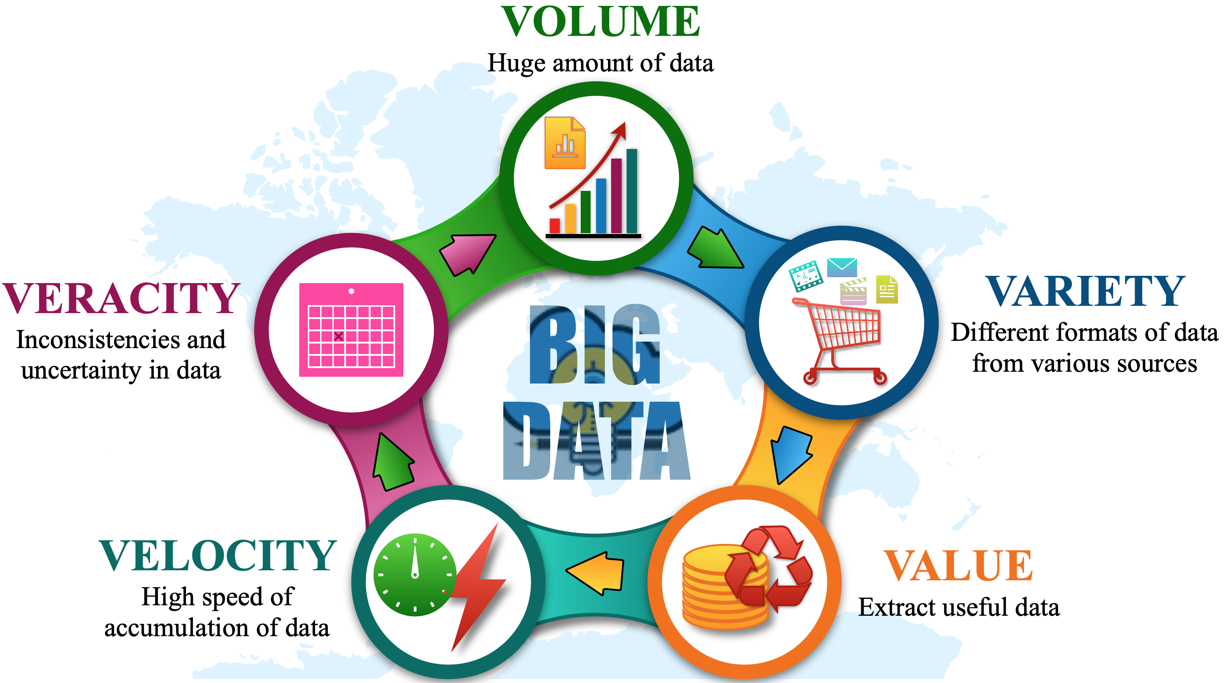
Characteristics of Big Data

Slide 13
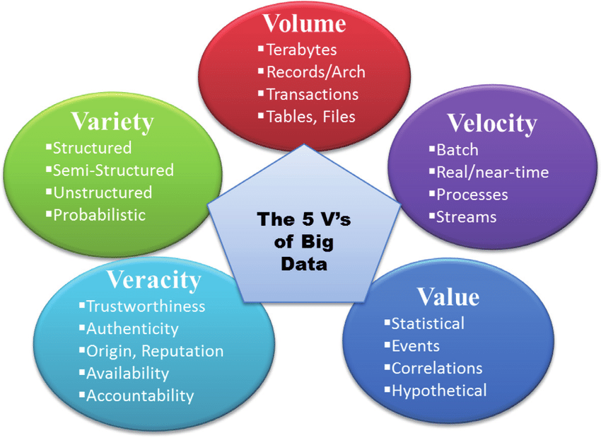

Slide 14
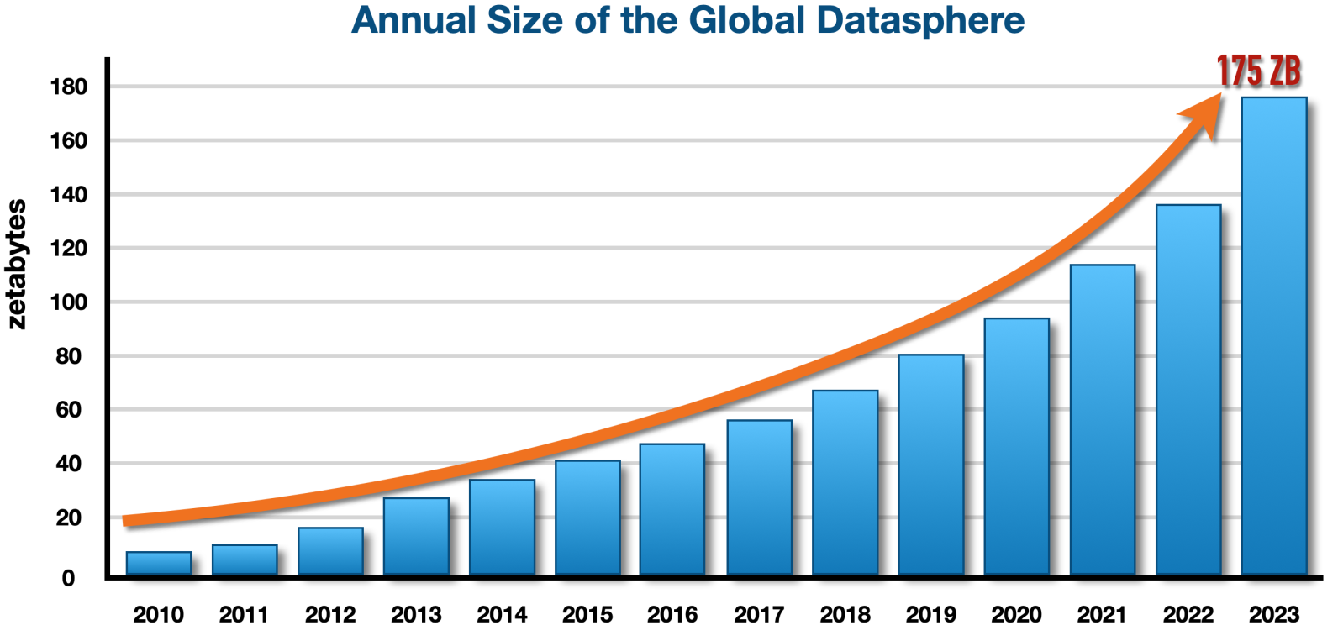
Characteristics of Big Data
Volume
Big data is a form of data whose volume is so large that it would not ﬁt on a single machine therefore specialized tools and frameworks are required to store process and analyze such data.

Slide 15
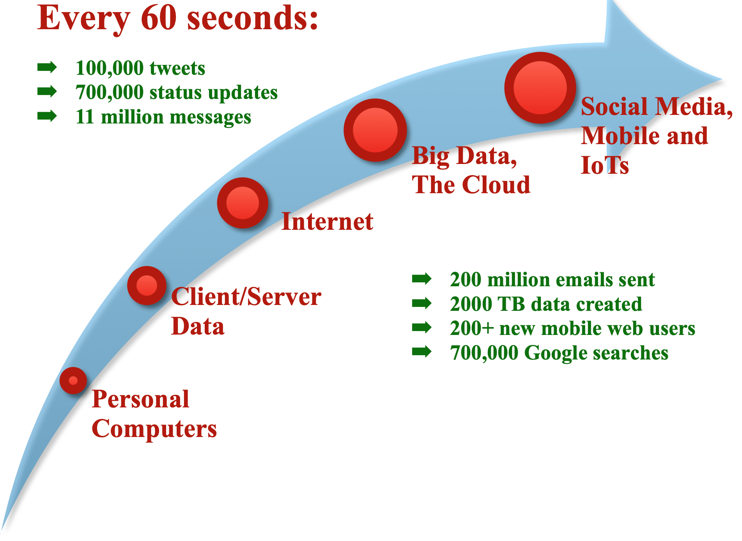
Characteristics of Big Data
Velocity
Velocity of data refers to how fast the data is generated. Data generated by certain sources can arrive at very high velocities, for example, social media data or sensor data.

Slide 16
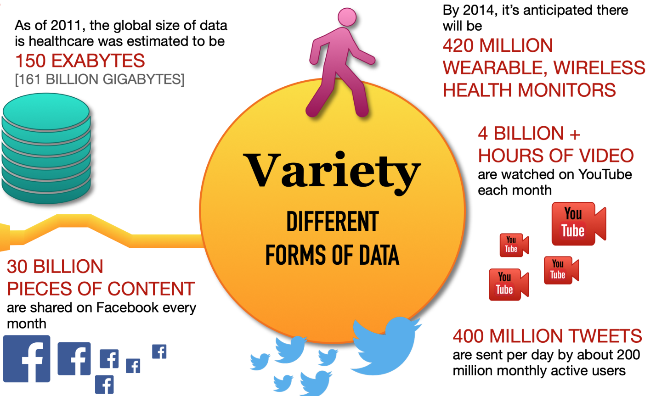
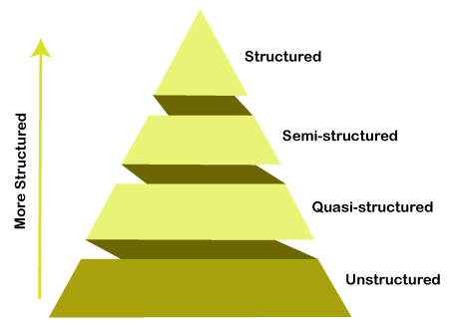
Characteristics of Big Data
Variety
Variety refers to the forms of the data. Big data comes in different forms such as structured, unstructured or semi-structured, including text data, image, audio, video and sensor data.

Slide 17
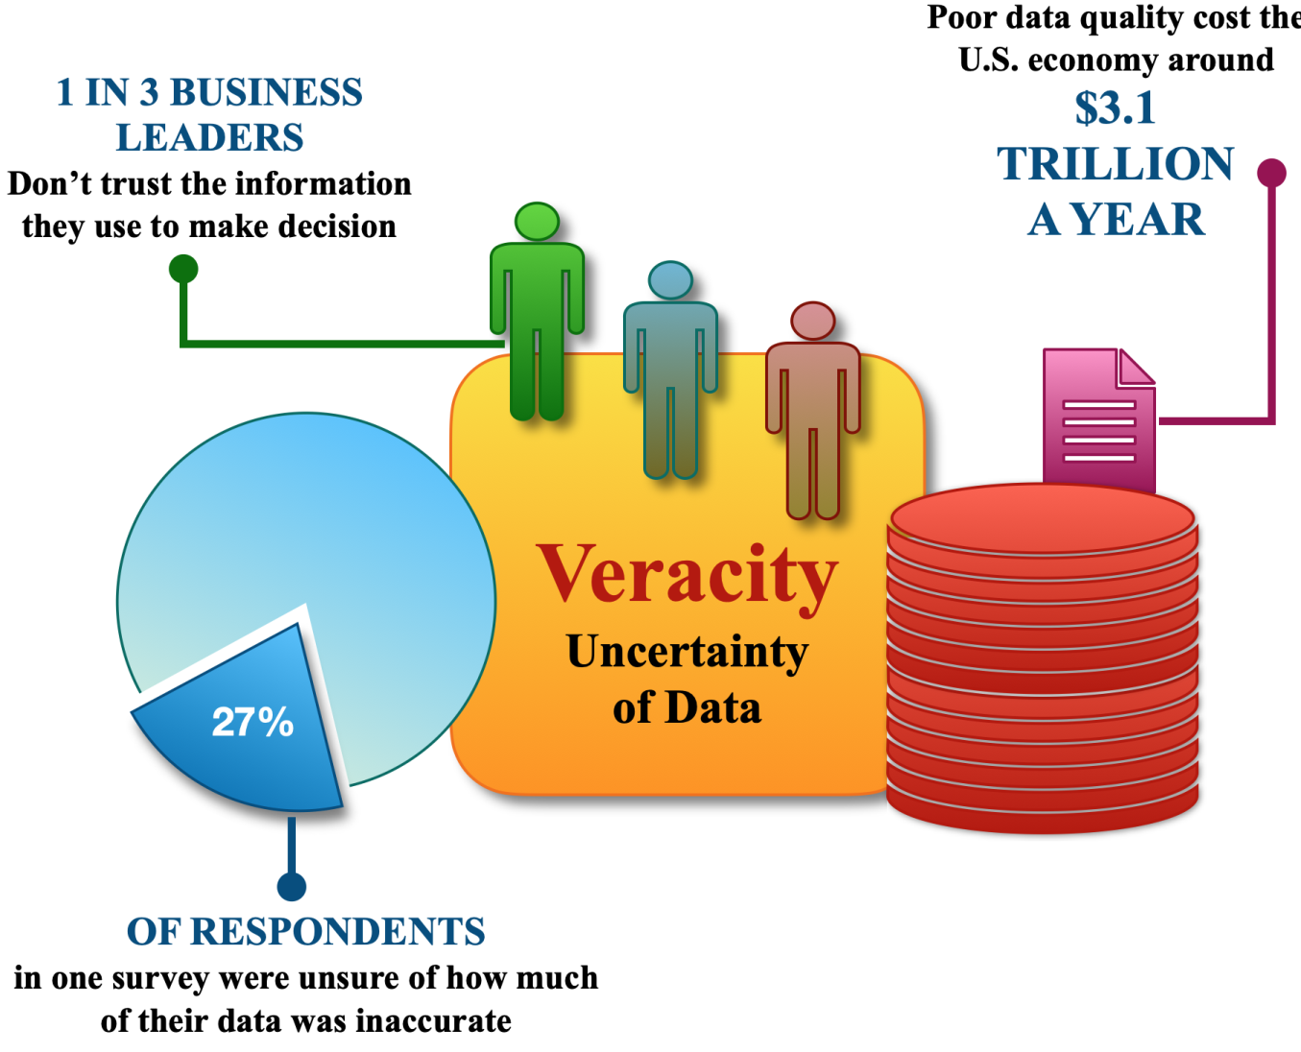
Characteristics of Big Data
Veracity
Veracity refers to how accurate is the data. To extract value from the data, the data needs to be cleaned to remove noise.

Slide 18
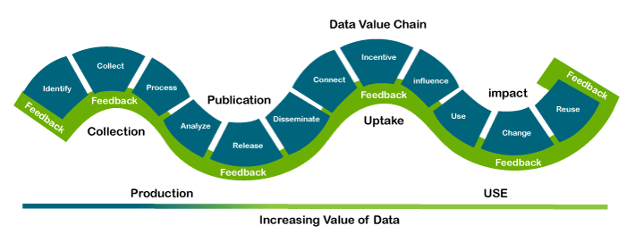
Characteristics of Big Data
Value
Value of data refers to the usefulness of data for the intended purpose. The end goal of any big data analytics system is to extract value from the data

Slide 19
Domain Speciﬁc Examples of Big Data
Web
Financial
Healthcare
Internet of Things
Environment
Logistics & Transportation
Industry
Retail

Slide 20
Domain Speciﬁc Examples of Big Data
Web
Web Analytics
Insights about web visitor engagement and tracking performance of online advertisement campaigns
Performance Monitoring
Predict application performance under heavy workloads and identify bottlenecks in the system
Ad Targeting and Analytics
Matching advertisements to the users and generating advertisement statistics reports
Content Recommendation
Recomending new content to the user based on user preferences and interests

Slide 21
Domain Speciﬁc Examples of Big Data
Financial
Credit Risk Modelling
Score credit applications and predict if a borrower will default or not in the future
Fraud Detection
Credit card frauds
Money laundering
Insurance claim frauds

Slide 22
Domain Speciﬁc Examples of Big Data
Healthcare
Patient similarity-based decision intelligence application
Analyse EHR data to extract a cluster of patient records most similar to a particular target patient
Adverse drug events prediction
Which patients are most at risk for having an adverse response to a certain drug based on adverse drug reactions of other patients
Real-time health monitoring
Analyse data from wearable devices to determine any health conditions or anomalies

Slide 23
Domain Speciﬁc Examples of Big Data
Internet of Things
Intrusion detection
Use data from security cameras and sensors to detect intrusions and raise alerts
Smart parking
Detect number of empty parking slots
Smart roads
Information on driving conditions, traffic congestions, accidents
Structural health monitoring
By monitoring vibration levels of structures such as bridges and buildings, detect cracks, mechanical breakdowns, damages to the structure, caclulate the remaining life of the structure

Slide 24
Domain Speciﬁc Examples of Big Data
Environment
Weather monitoring
Air pollution monitoring
Noise pollution monitoring
Forest fire detection
River floods detection
Water quality measuring

Slide 25
Domain Speciﬁc Examples of Big Data
Logistics & Transportation
Real time fleet tracking
Shipment monitoring
Remote vehicle diagnosis
Route generation and scheduling

Slide 26
Domain Speciﬁc Examples of Big Data
Industry
Machine diagnosis and prognosis
Risk analysis of industrial operations
Production planning and control

Slide 27
Domain Speciﬁc Examples of Big Data
Retail
Inventory management
Customer recommendations
Store layout optimization
Forecasting demand

Slide 29
Analytics Flow for Big Data
Data Collection
Data collection is the ﬁrst step for any analytics application. Before the data can be analyzed, the data must be collected and ingested into a big data stack. The choice of tools and frameworks for data collection depends on the source of data and the type of data being ingested.
Data Preparation
Data can often be dirty and can have various issues that must be resolved before the data can be processed, such as corrupt records, missing values, duplicates, inconsistent abbreviations, inconsistent units, typos, incorrect spellings and incorrect formatting. Data preparation step involves various tasks such as data cleansing, data wrangling or munging, de-duplication, normalization, sampling and ﬁltering.

Slide 30
Analytics Flow for Big Data
Analysis Types
The next step in the analysis ﬂow is to determine the analysis type for the application.
Analysis Modes
With the analysis types selected for an application, the next step is to determine the analysis mode, which can be either batch, real-time or interactive. The choice of the mode depends on the requirements of the application.
Visualizations
The choice of the visualization tools, serving databases and web frameworks is driven by the requirements of the application. Visualizations can be static, dynamic or interactive.

Slide 31
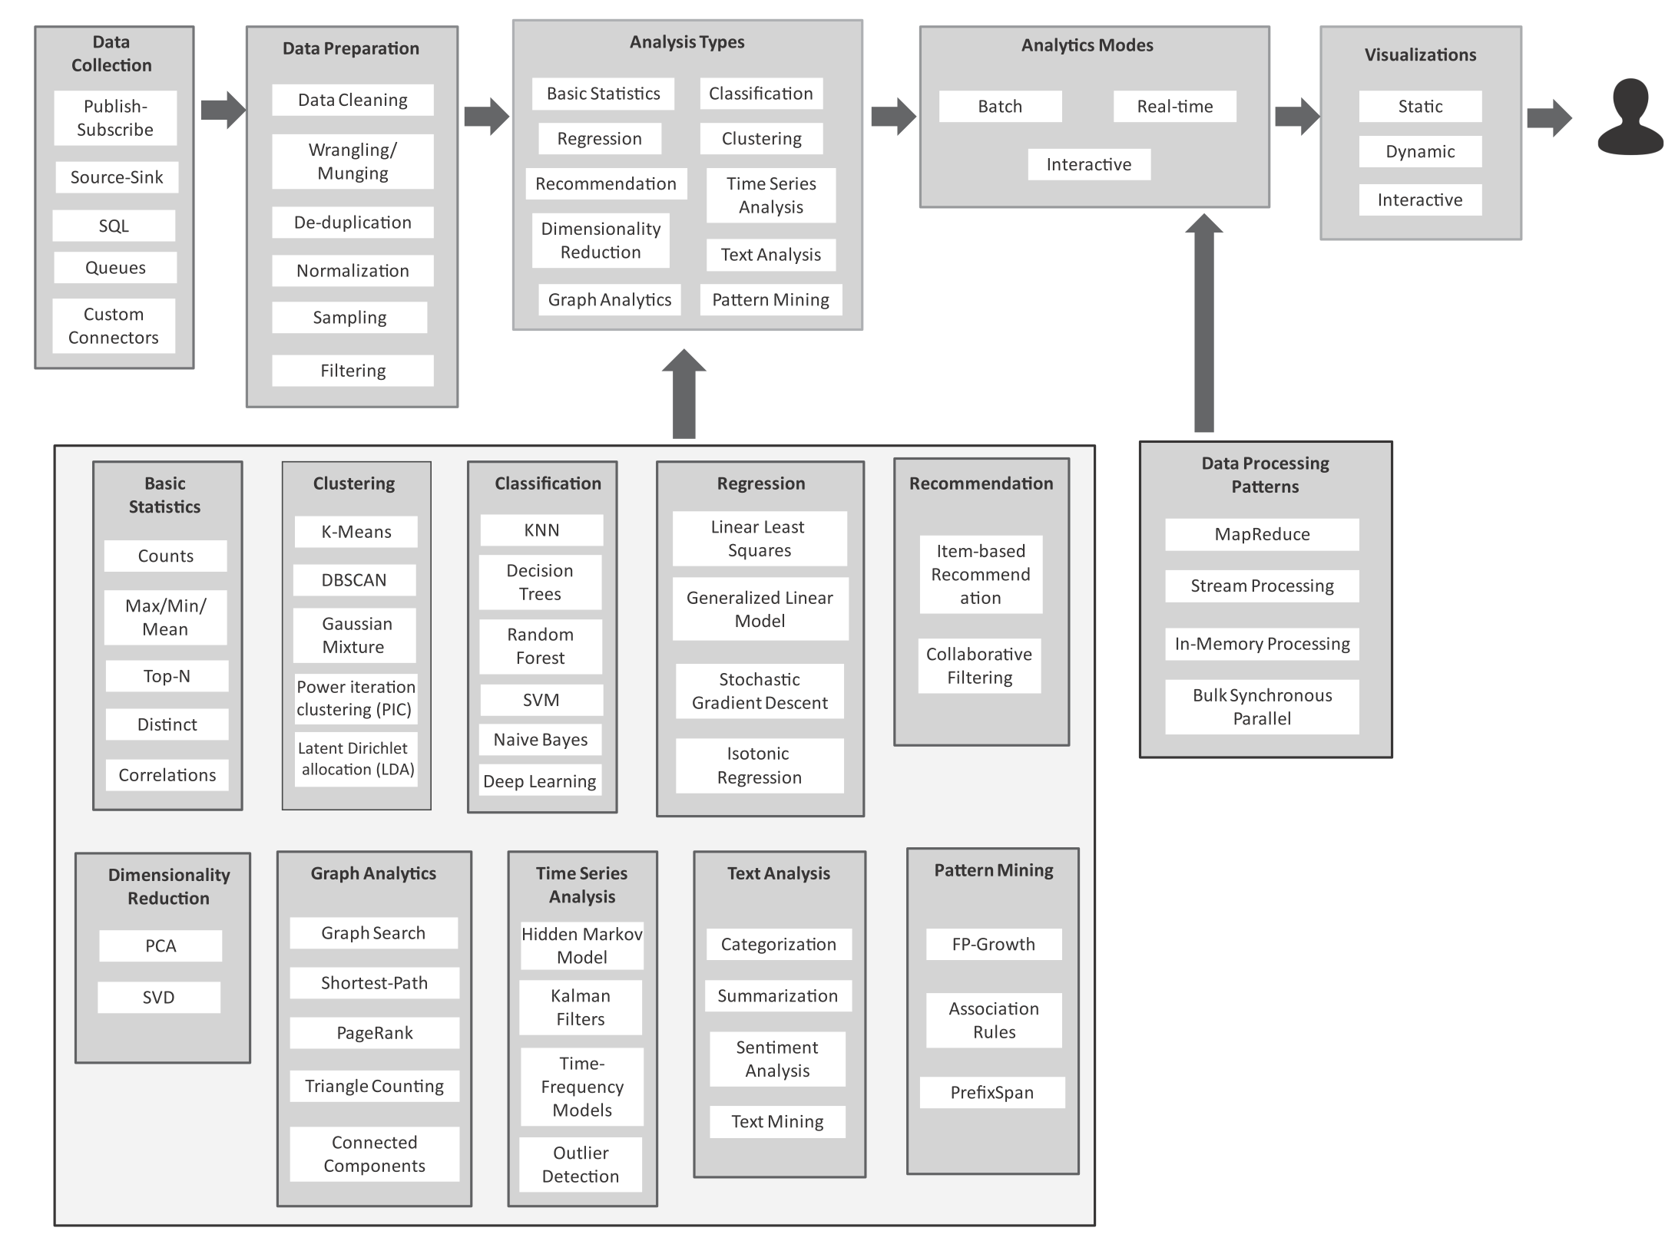
Analytics Flow for Big Data

Slide 32
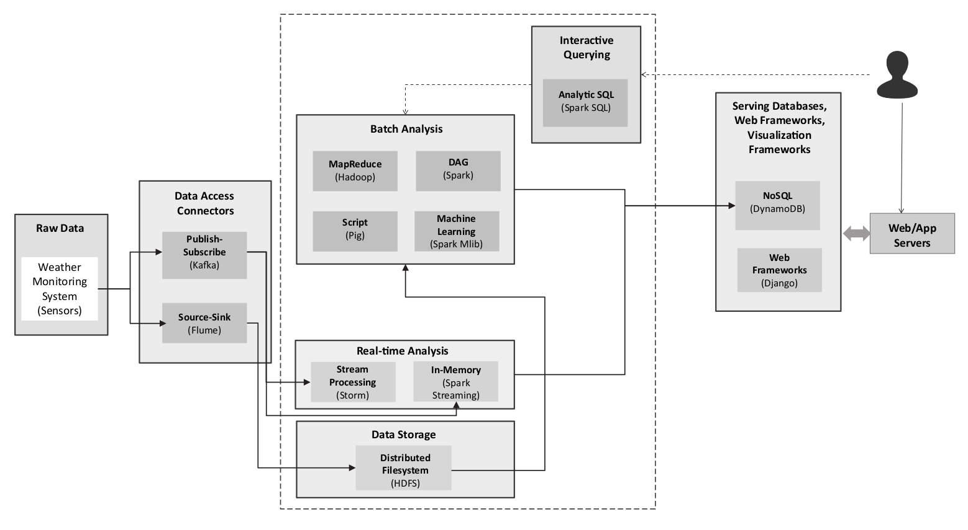
Big Data Stack

Slide 33
Big Data Stack
Capture data from the raw data sources into the big data systems and frameworks.

Slide 34
Big Data Stack
tools and frameworks for collecting and ingesting data from various sources into the big data storage and analytics frameworks.

Slide 35
Big Data Stack
process and analyze the data
Storage and analytics frameworks

Slide 36
Big Data Stack
process and analyze the data
store the data collected from the raw data sources using the data access connectors

Slide 37
Big Data Stack
process and analyze the data
various frameworks which allow analysis of data in batches

Slide 38
Big Data Stack
process and analyze the data
The real-time analytics block

Slide 39
Big Data Stack
process and analyze the data
allow users to query data

Slide 40
Big Data Stack
allow the analyzed data to be queried and presented in the web applications

Slide 41
Big Data Stack
Raw Data Sources
In any big data analytics application or platform, before the data is processed and analyzed, it must be captured from the raw data sources into the big data systems and frameworks.
Data Access Connectors
The Data Access Connectors includes tools and frameworks for collecting and ingesting data from various sources into the big data storage and analytics frameworks. The choice of the data connector is driven by the type of the data source.
Data Storage
The data storage block in the big data stack includes distributed ﬁlesystems and non-relational (NoSQL) databases, which store the data collected from the raw data sources using the data access connectors.

Slide 42
Big Data Stack
Batch Analytics
The batch analytics block in the big data stack includes various frameworks which allow analysis of data in batches such as Hadoop-MapReduce, Pig, Oozie, Pig, Spark, Solr.
Real-time Analytics
The real-time analytics block includes the Apache Storm and Spark Streaming frameworks.
Interactive Querying
Interactive querying systems allow users to query data by writing statements in SQL-like languages.
Serving Databases, Web & Visualization Frameworks
While the various analytics blocks process and analyze the data, the results are stored in serving databases for subsequent tasks of presentation and visualization. These serving databases allow the analyzed data to be queried and presented in the web applications.

Slide 43
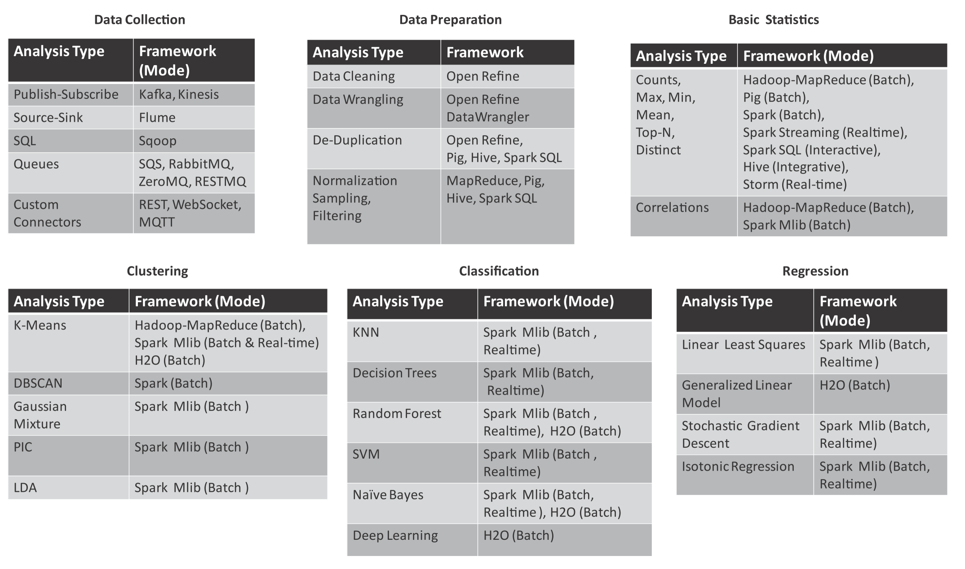
Mapping Analytics Flow to Big Data Stack

Slide 44
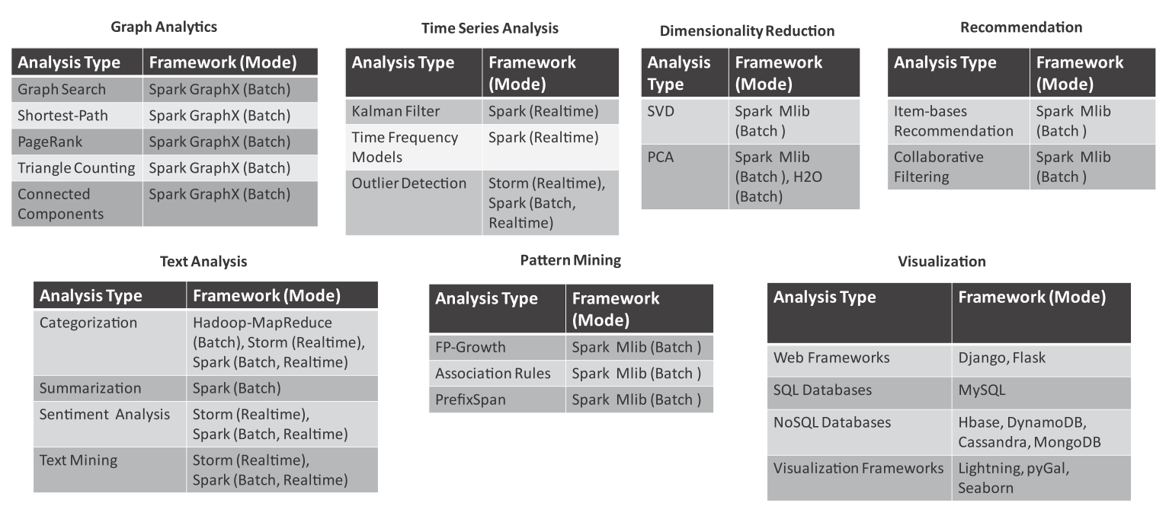
Mapping Analytics Flow to Big Data Stack

Slide 45
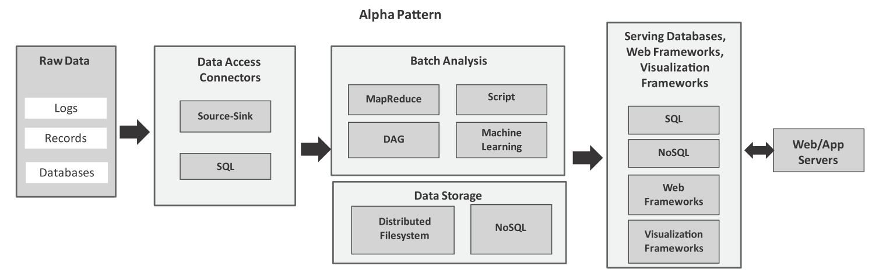
Analytics Patterns
Alpha Pattern for batch data analysis
This pattern can be used for ingesting large volumes of data into a distributed ﬁlesystem (such as HDFS) or a NoSQL database (such as HBase) using source-sink connectors (such as Flume) and SQL connectors (such as Sqoop). After the data is moved to the stack, the data can be analyzed in batch mode with batch analysis frameworks including MapReduce (using Hadoop), scripting frameworks (such as Pig), distributed acyclic graph frameworks (such as Spark), machine learning frameworks (such as Spark MLlib). The analysis results are stored either in relational or non-relational databases.

Slide 46
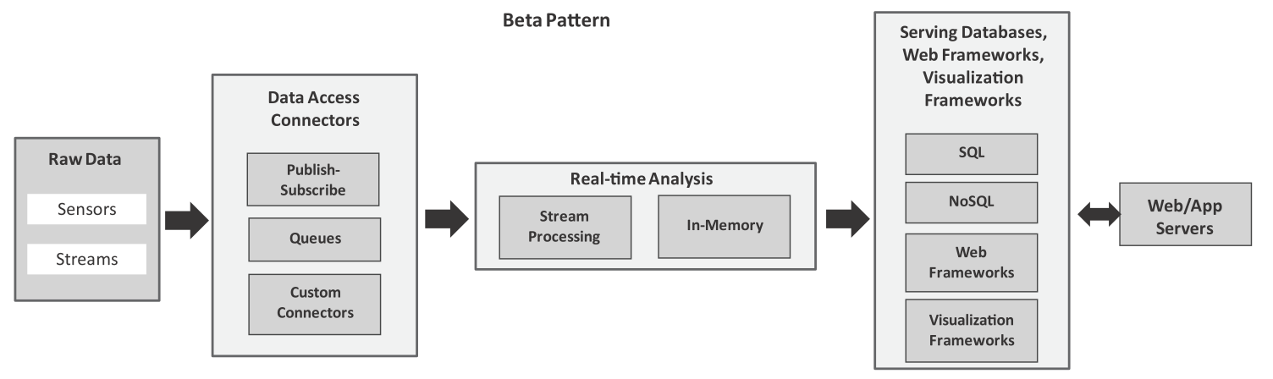
Analytics Patterns
Beta Pattern for real-time data analysis
This pattern can be used for ingesting streaming data using publish-subscribe messaging frameworks, queues and custom connectors. For real-time analysis, we can use stream processing frameworks (such as Storm) or in-memory processing frameworks (such as Spark).

Slide 47
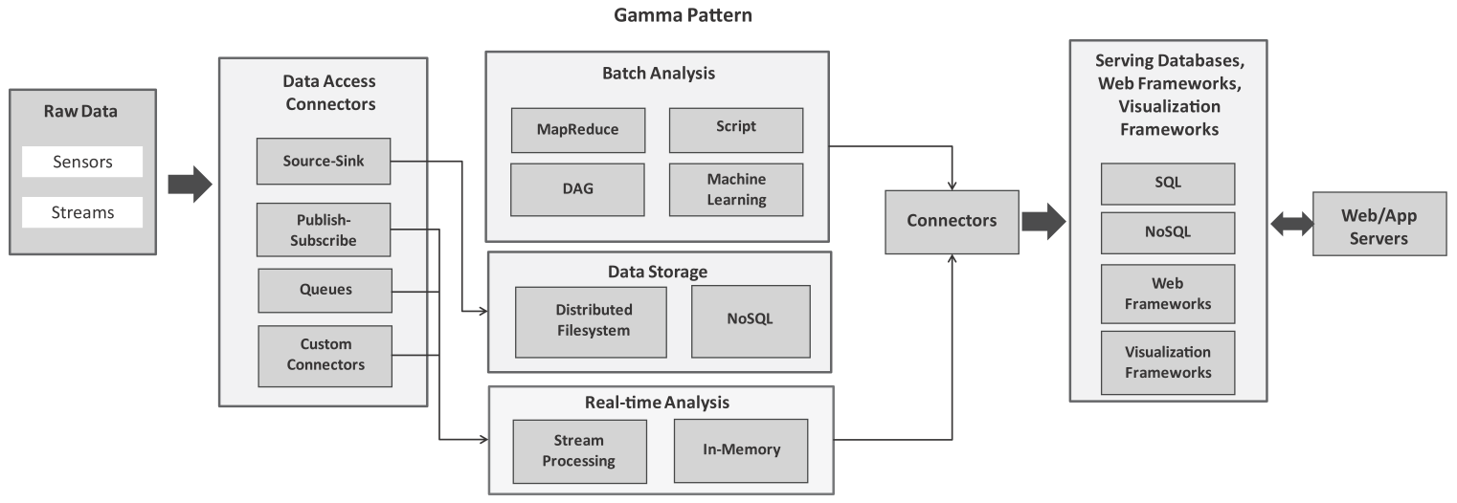
Analytics Patterns
Gamma Pattern for a combination of real-time and batch data analysis
This pattern is meant for ingesting streaming data into a big data stack and analyzing the data both in real-time and in batch modes.

Slide 48
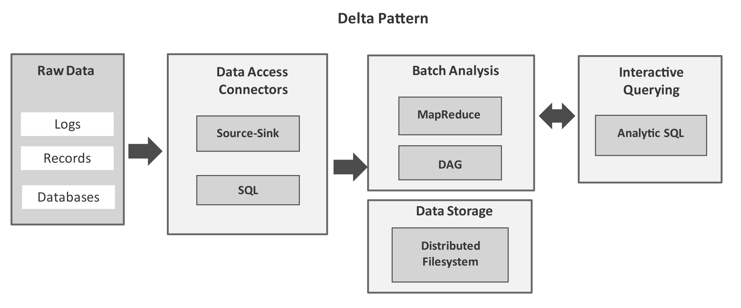
Analytics Patterns
Delta Pattern for interactive querying
This pattern uses, source-sink connectors (such as Flume) or SQL connectors (such as Sqoop) to ingest bulk data into the big data stack. After the data is moved to a distributed ﬁlesystem, you can use interactive querying frameworks (such as Hive or Spark SQL) for querying data with SQL-like queries in an interactive mode.

Slide 49
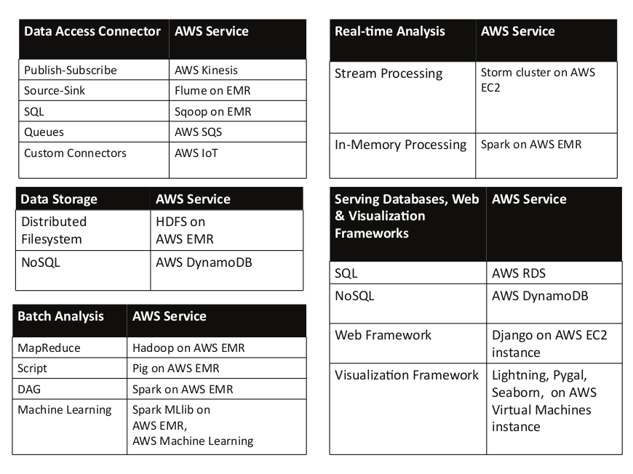
Mapping of blocks in analytics patterns to AWS services

Slide 50
Mapping of blocks in analytics patterns to AWS services

Slide 51
Collecting data from various data sources into distributed file system for analysis

Slide 52
Outline
Amazon Kinesis
AWS IoT
Example - Air Quality Monitoring Application

Slide 53
Collecting data from various data sources into distributed file system for analysis

Slide 54
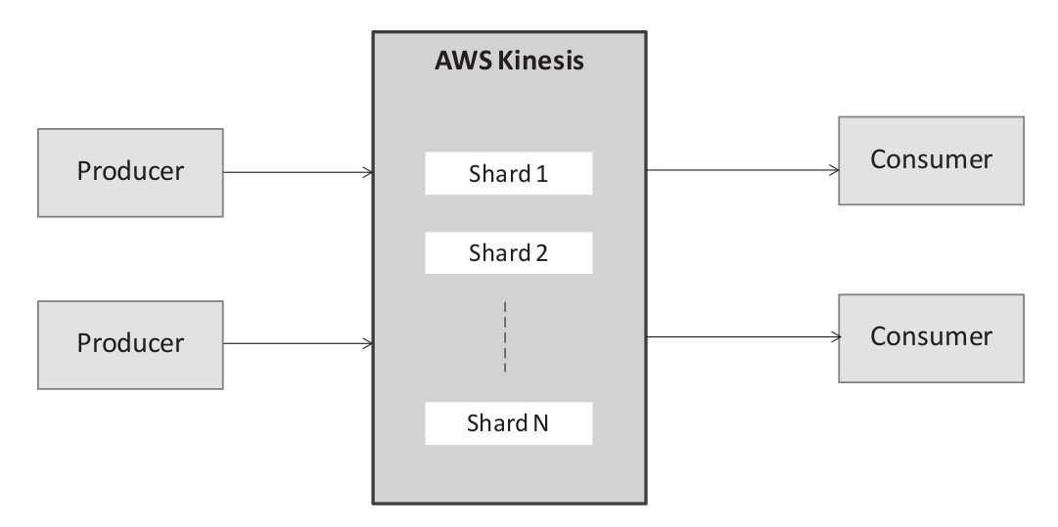
Amazon Kinesis
Amazon Kinesis is a fully managed commercial service for ingesting real-time streaming data. Kinesis scales automatically to handle high volume streaming data coming from a large number of sources.

Slide 55
Amazon Kinesis
Amazon Kinesis provides the following services for collecting, processing, and analyzing data and video streams in real-time:
Kinesis Data Streams
Kinesis Firehose Delivery Streams
Kinesis Analytics Applications
Kinesis Video Streams

Slide 56
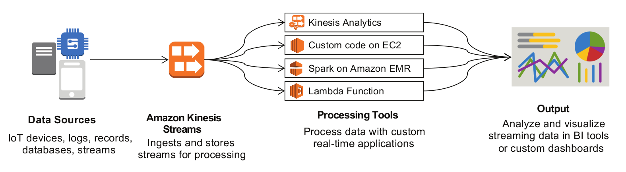
Kinesis Data Streams
Kinesis Data Streams allow you to ingest and process streaming data. The streaming data can either be processed with your applications, or using AWS managed services like Amazon Kinesis Data Firehose, Amazon Kinesis Data Analytics, or AWS Lambda

Slide 57
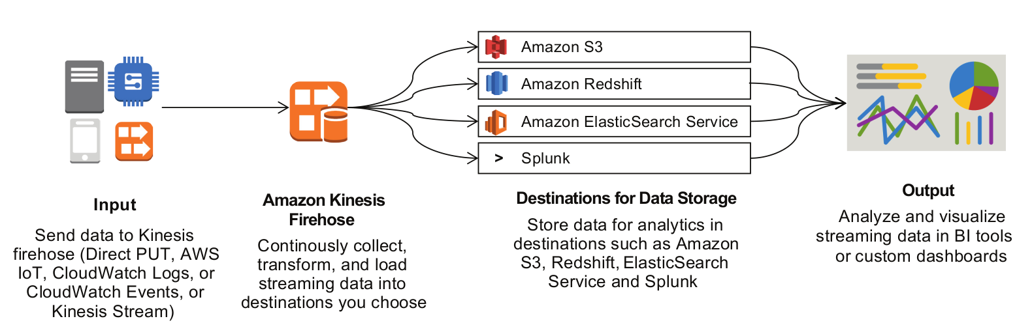
Kinesis Firehose Delivery Streams
Amazon Kinesis Data Firehose is a fully managed service for continuously collecting, transforming, and loading streaming data into destinations such as Amazon S3, Amazon Redshift, Amazon Elasticsearch Service, and Splunk.

Slide 58
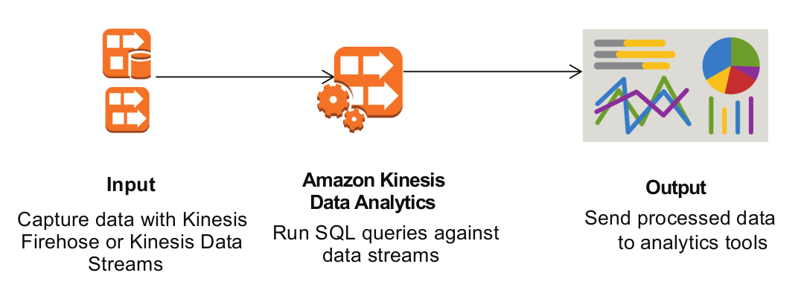
Kinesis Analytics
Kinesis Analytics is a service that allows you to run continuous SQL queries on streaming data from Kinesis data streams and Kinesis Firehose delivery streams.

Slide 59
Kinesis Video Streams
Kinesis Video Streams is a service that you can use to stream live video from devices to the AWS Cloud, or build applications for real-time video processing or batch-oriented video analytics.

Slide 60
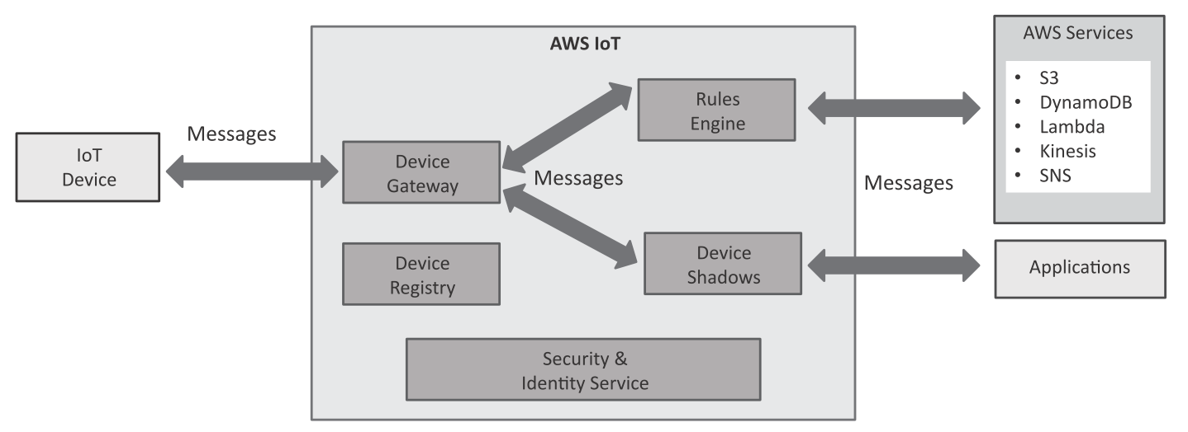
AWS IoT
Amazon IoT is a service for collecting data from Internet of Things (IoT) devices (such as sensors and smart appliances) into the AWS cloud. The data collected can be sent to various AWS services, e.g. stored in Amazon DynamoDB database, stored in a ﬁle on S3, sent to an Amazon Kinesis data stream, sent to Amazon SNS as a push notiﬁcation and inserted into a code for executing it with Amazon Lambda service.

Slide 61
AWS IoT
Device Gateway: Device Gateway enables devices to communicate with AWS IoT using MQTT or HTTP protocols. Devices can publish or subscribe to topics.

Slide 62
AWS IoT
Device Registry: Device registry (also called things registry) maintains the resources associated with each device, including attributes, certificates, and meta-data.

Slide 63
AWS IoT
Device Shadow: Device shadow maintains the state of a device as a JSON document. Applications can retrieve or update the device state using the AWS IoT REST APIs. Device shadow persists the state of the device even when the device is offline. When a device becomes online, the state is synchronized with the device shadow.

Slide 64
AWS IoT
Rules Engine: Rules engine allows you to define rules for processing messages received from devices. Using an SQL-like language, you can define rules to select data, process data, and send the data to other AWS services such as DynamoDB, S3,Kinesis, SNS, and Lambda.

Slide 65
AWS IoT
Security and Identity Service: This service allows devices to exchange data with the AWS IoT service securely. For devices communicating via MQTT, certificate-based authentication is used. Certificates have policies associated with them which authorize devices to access specific resources.

Slide 66
AWS IoT Actions
Insert a message into a DynamoDB table
Split message into multiple columns of a database table
Invoke a Lambda function passing the message data
Send a message as an SNS push notification
Send a message to an SQS queue
Sends messages to an Amazon Kinesis Stream
Republish messages to an AWS IoT topic
Store messages in an Amazon S3 bucket
Send messages to an Amazon Kinesis Firehose stream
Send message data to CloudWatch
Change the state of a CloudWatch alarm
Send messages to the Amazon Elasticsearch Service
Send message to a Salesforce IoT Input Stream
Send message to an IoT Analytics Channel
Start a Step Functions state machine execution

Slide 67
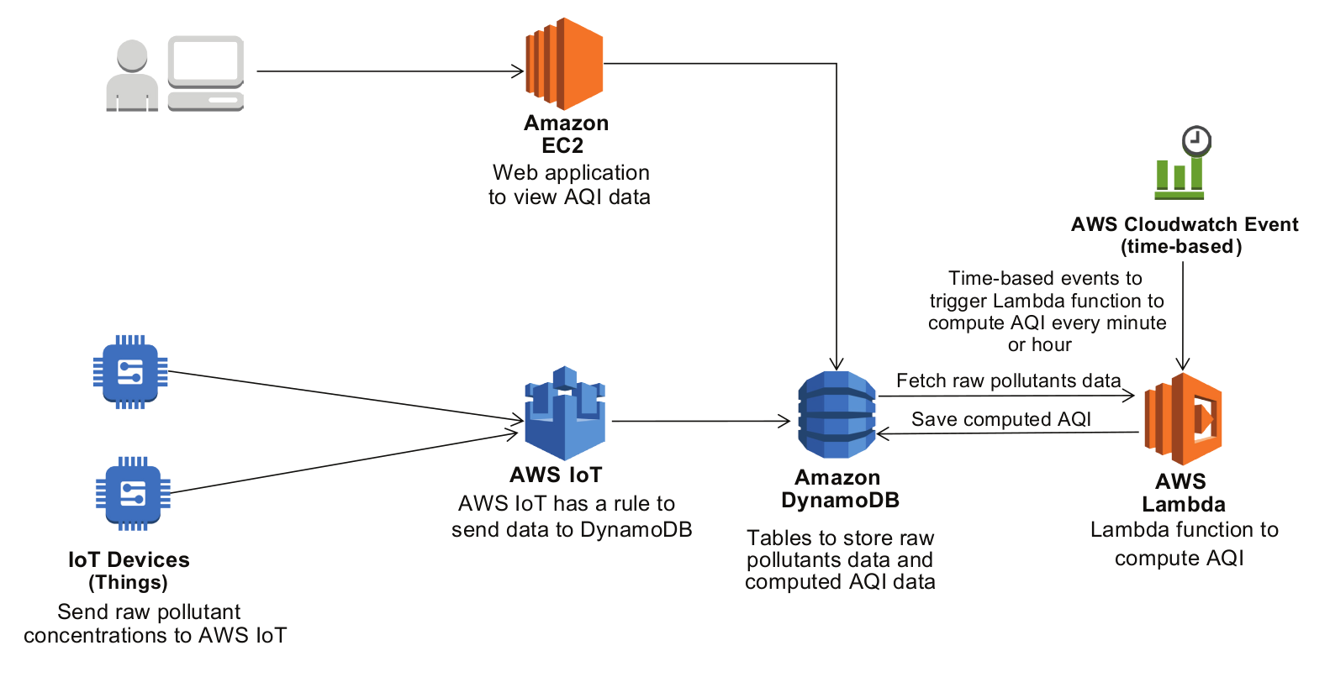
Example: Air Quality Monitoring Application
Variant-1 using AWS IoT, DynamoDB, Lambda, CloudWatch & EC2

Slide 68
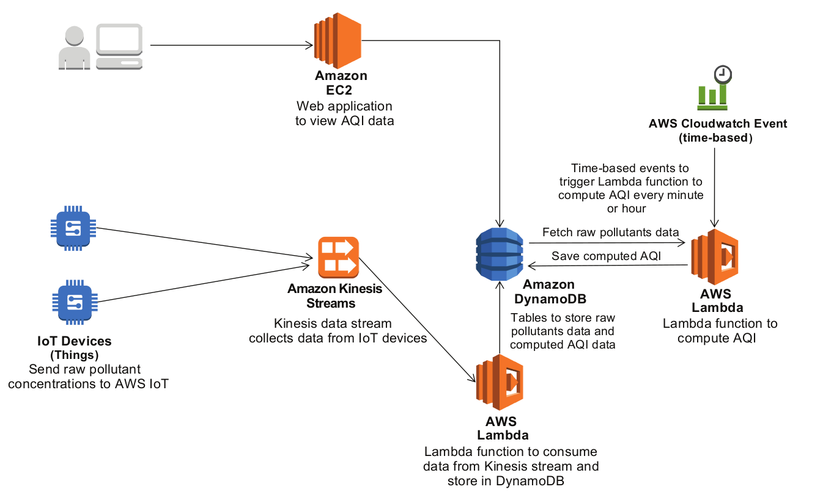
Example: Air Quality Monitoring Application
Variant-2 using Kinesis Streams, DynamoDB, Lambda, CloudWatch & EC2

Slide 69
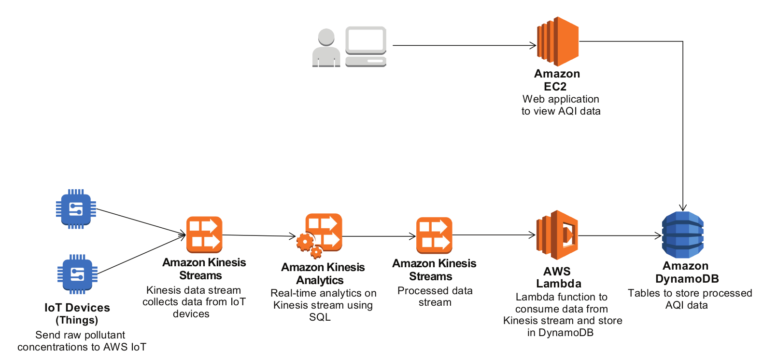
Example: Air Quality Monitoring Application
Variant-3 using Kinesis Streams, Kinesis Analytics, Lambda, & EC2

Slide 70
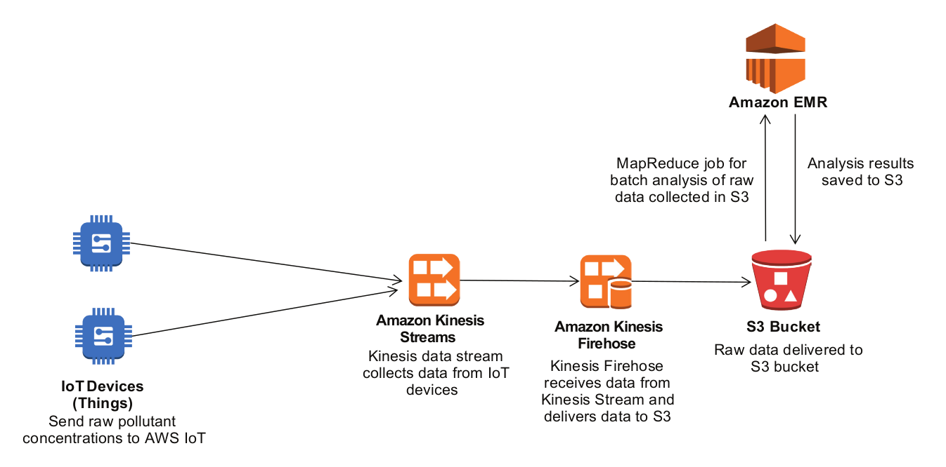
Example: Air Quality Monitoring Application
Variant-4 using Kinesis Streams, Kinesis Firehose, S3 & EMR

Slide 71
Batch Analytics

Slide 72
Outline
AWS EMR
Hadoop Distributed File System (HDFS)
Hadoop and MapReduce
Pig
Apache Oozie
Apache Spark
Apache Solr

Slide 73
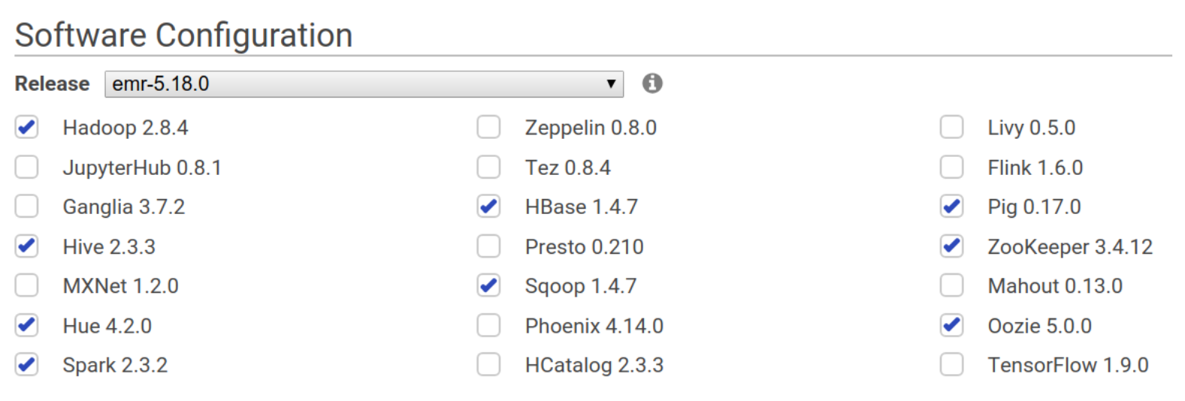
Amazon Elastic MapReduce (EMR)
Amazon Elastic MapReduce is a managed big data cluster platform that supports the following frameworks:

Slide 74
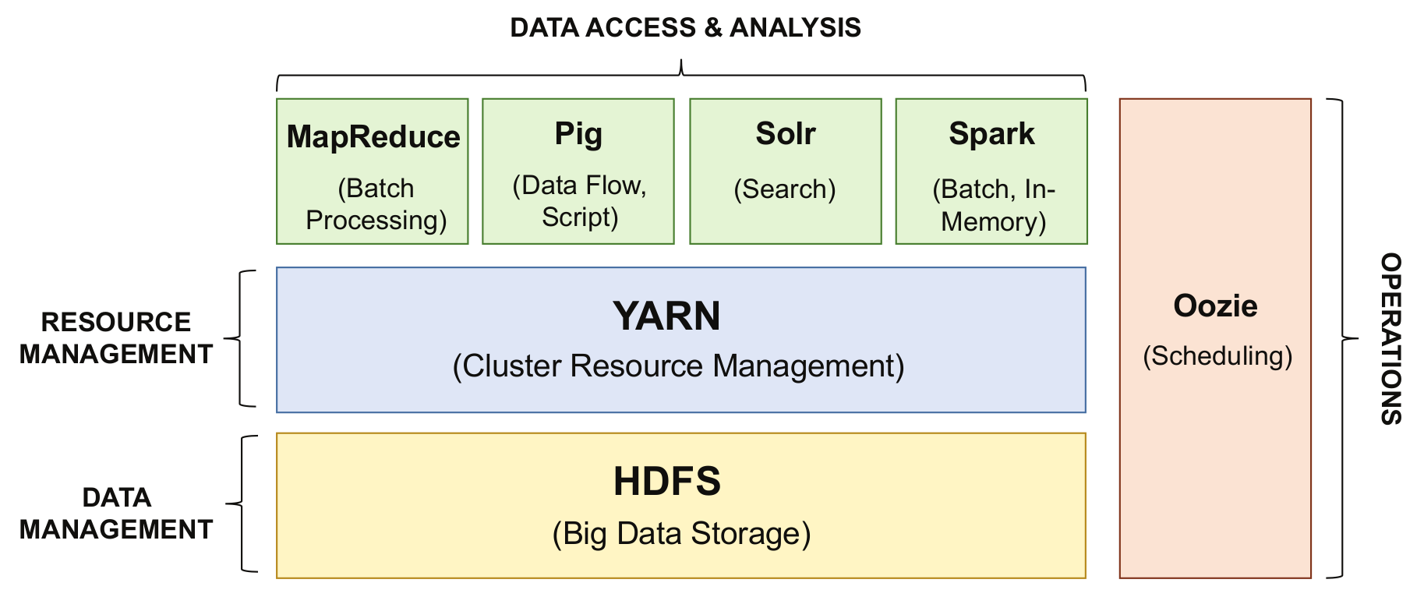
Big Data Batch Processing Tools

Slide 75
Big Data Batch Processing Tools

Slide 76
HDFS
HDFS is a distributed ﬁle system (DFS) that runs on large clusters and provides high-throughput access to data.
HDFS is a highly fault-tolerant system and is designed to work with commodity hardware.
HDFS stores each ﬁle as a sequence of blocks.
The blocks of each ﬁle are replicated on multiple machines in a cluster to provide fault tolerance.

Slide 77
Big Data Batch Processing Tools

Slide 78
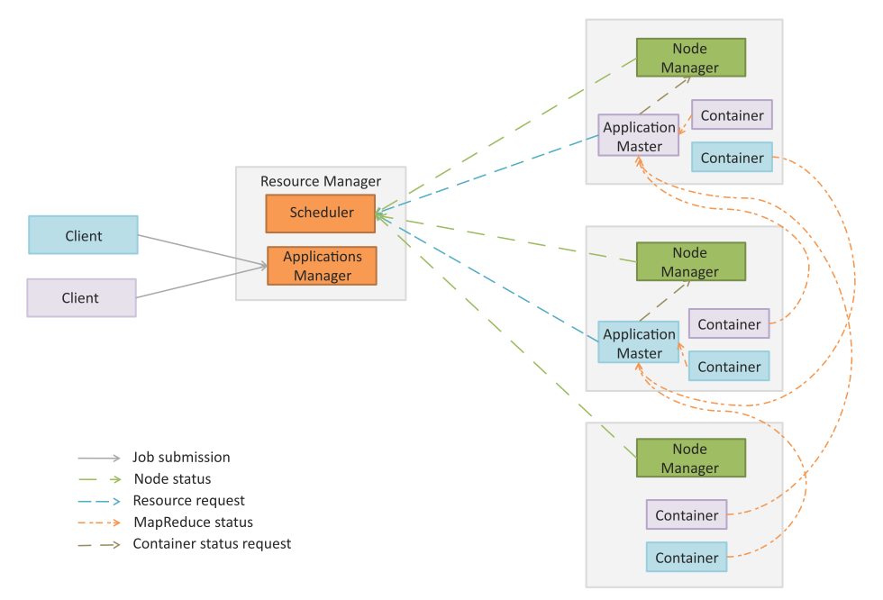
MapReduce 2.0 - YARN
In Hadoop 2.0 the original processing engine of Hadoop (MapReduce) has been separated from the resource management (which is now part of YARN).
This makes YARN effectively an operating system for Hadoop that supports different processing engines on a Hadoop cluster such as MapReduce for batch processing, Apache Tez for interactive queries, Apache Storm for stream processing, etc.

Slide 79
YARN
YARN architecture divides architecture divides the two major functions of the JobTracker - resource management and job life-cycle management - into separate components:
ResourceManager
ApplicationMaster.

Slide 80
YARN Components
Resource Manager (RM): RM manages the global assignment of compute resources to applications. RM consists of two main services:
Scheduler: Scheduler is a pluggable service that manages and enforces the resource scheduling policy in the cluster.
Applications Manager (AsM): AsM manages the running Application Masters in the cluster. AsM is responsible for starting application masters and for monitoring and restarting them on different nodes in case of failures.

Slide 81
YARN Components
Application Master (AM): A per-application AM manages the application’s life cycle. AM is responsible for negotiating resources from the RM and working with the NMs to execute and monitor the tasks.
Node Manager (NM): A per-machine NM manages the user processes on that machine.
Containers: Container is a bundle of resources allocated by RM (memory, CPU, network, etc.). A container is a conceptual entity that grants an application the privilege to use a certain amount of resources on a given machine to run a component task.

Slide 82
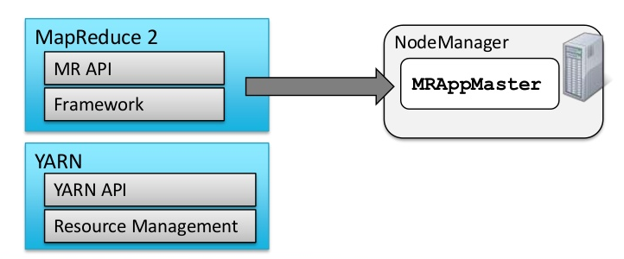
YARN and MapReduce (MR2)
YARN does not know or care what application it is running
Could be MapReduce or something else
MR2 uses YARN
Hadoop includes a MapReduce Application Master to manage MR jobs
Each MapReduce job is a new instance of a MapReduce application

Slide 83
Big Data Batch Processing Tools

Slide 84
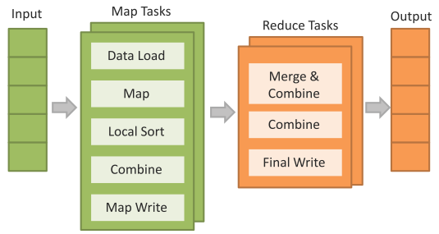
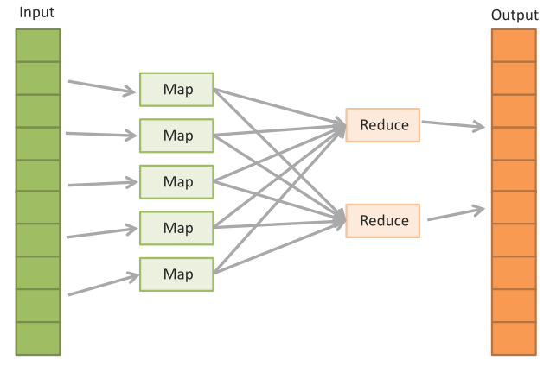
MapReduce
MapReduce is a parallel data processing model for processing and analysis of massive scale data.
MapReduce phases:
Map Phase: In the Map phase, data is read from a distributed file system, partitioned among a set of computing nodes in the cluster, and sent to the nodes as a set of key-value pairs.
The Map tasks process the input records independently of each other and produce intermediate results as key-value pairs.
The intermediate results are stored on the local disk of the node running the Map task.
Reduce Phase: When all the Map tasks are completed, the Reduce phase begins in which the intermediate data with the same key is aggregated.
Optional Combine Task
An optional Combine task can be used to perform data aggregation on the intermediate data of the same key for the output of the mapper before transferring the output to the Reduce task.

Slide 85
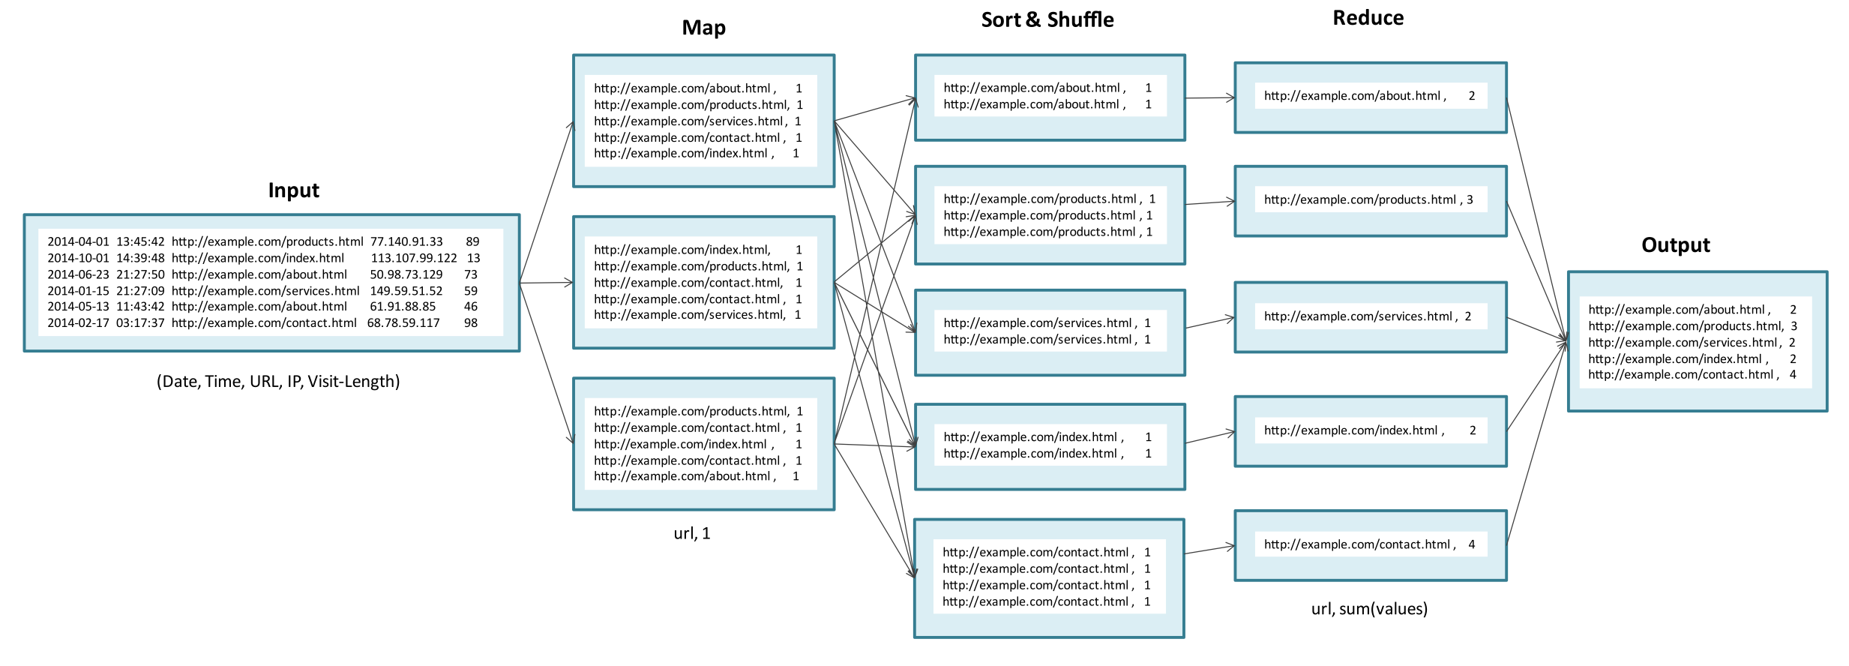
Numerical Summarization
Numerical summarization patterns are used to compute various statistics such as counts, maximum, minimum, mean, etc.

Slide 86
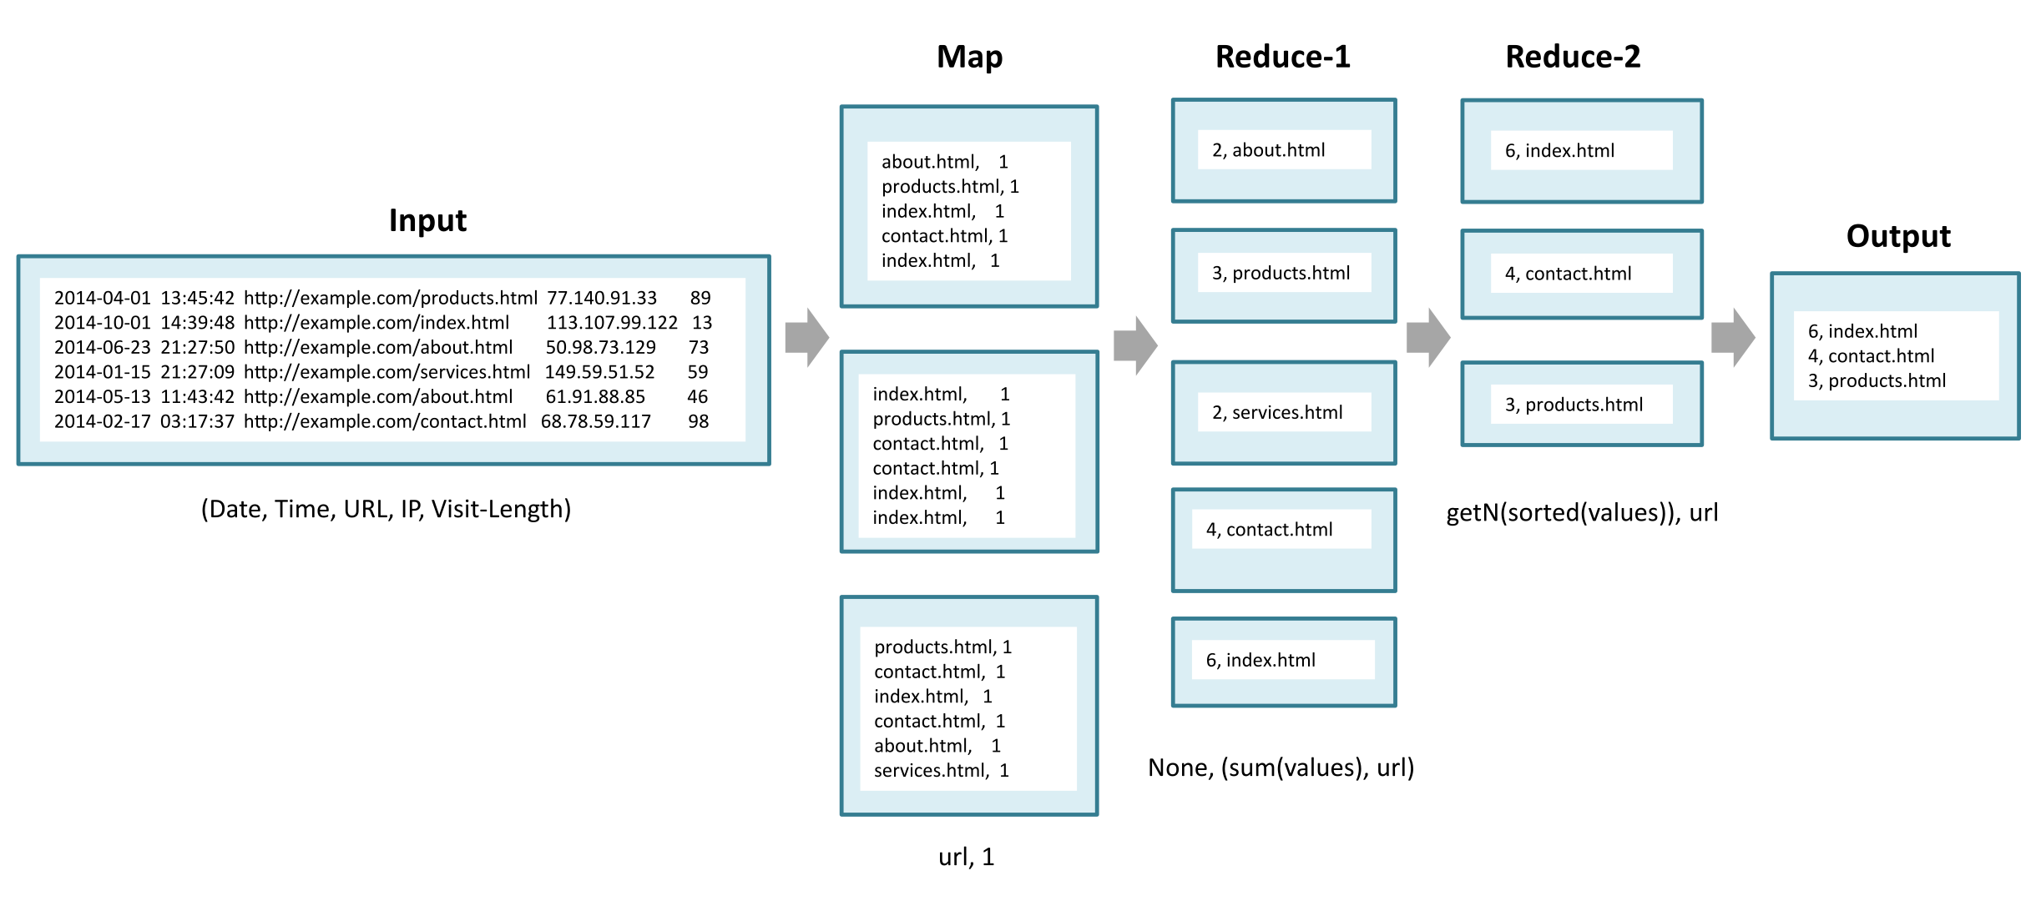
Top-N

Slide 87
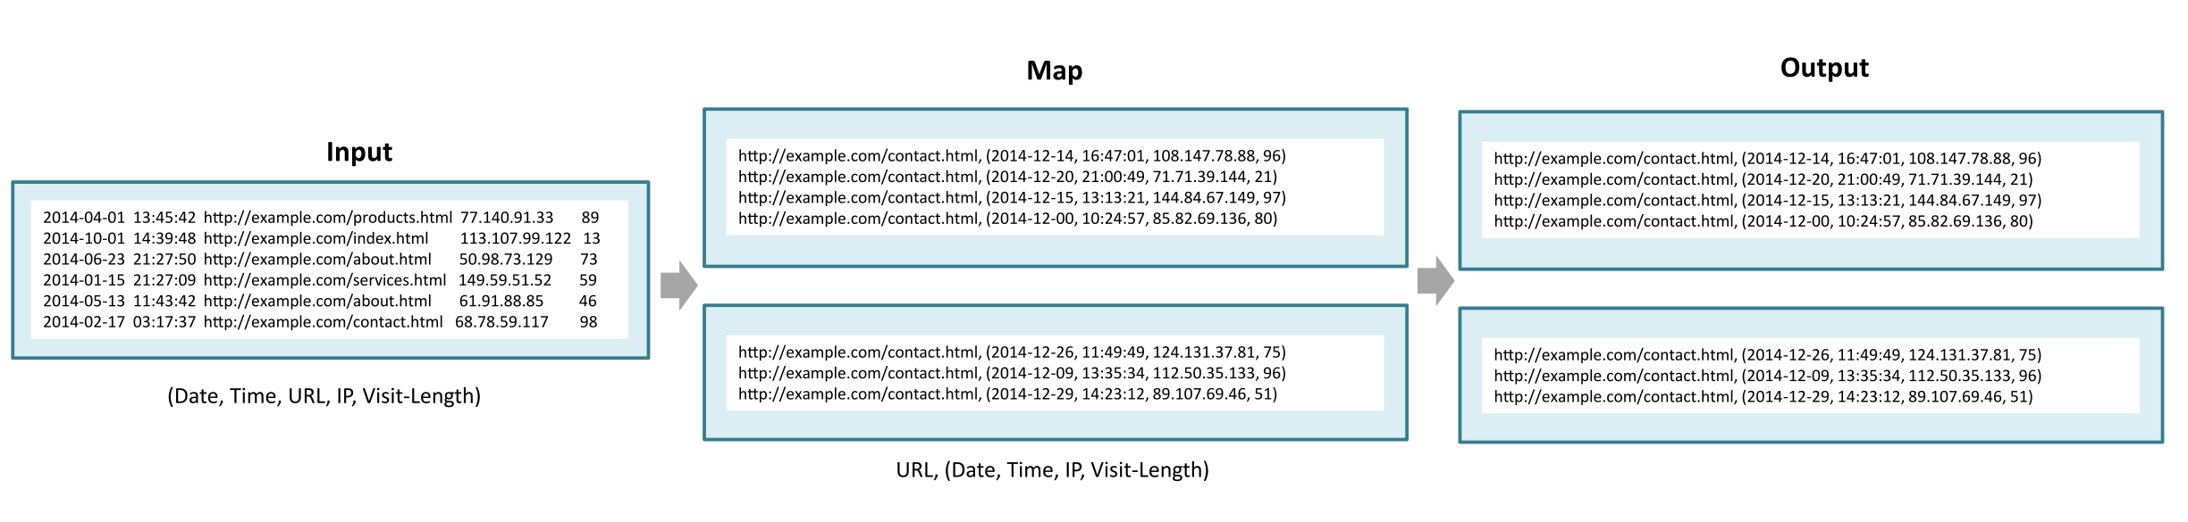
Filter
The ﬁltering pattern is used to ﬁlter out a subset of the records based on a ﬁltering criteria.

Slide 88
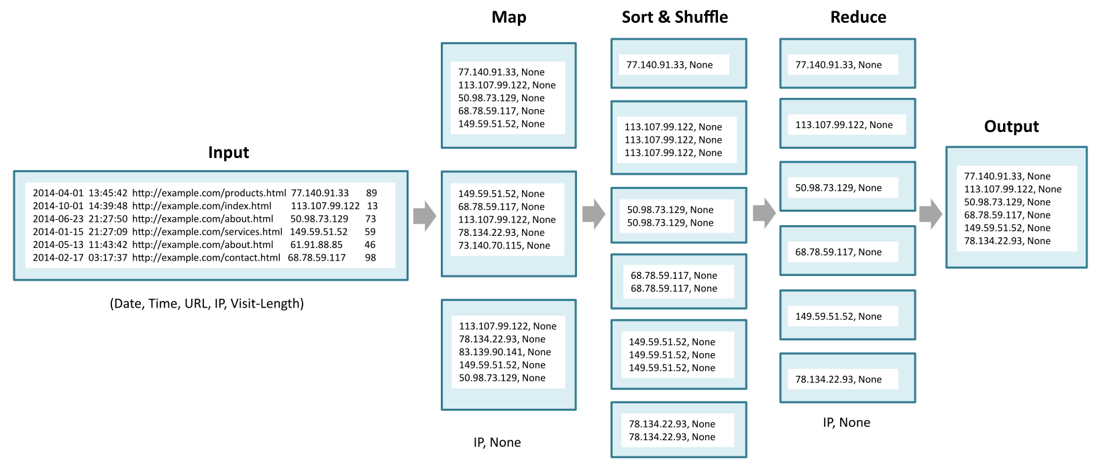
Distinct
Distinct pattern is used to ﬁlter out duplicate records or emit distinct values of sub-ﬁelds in the dataset.

Slide 89
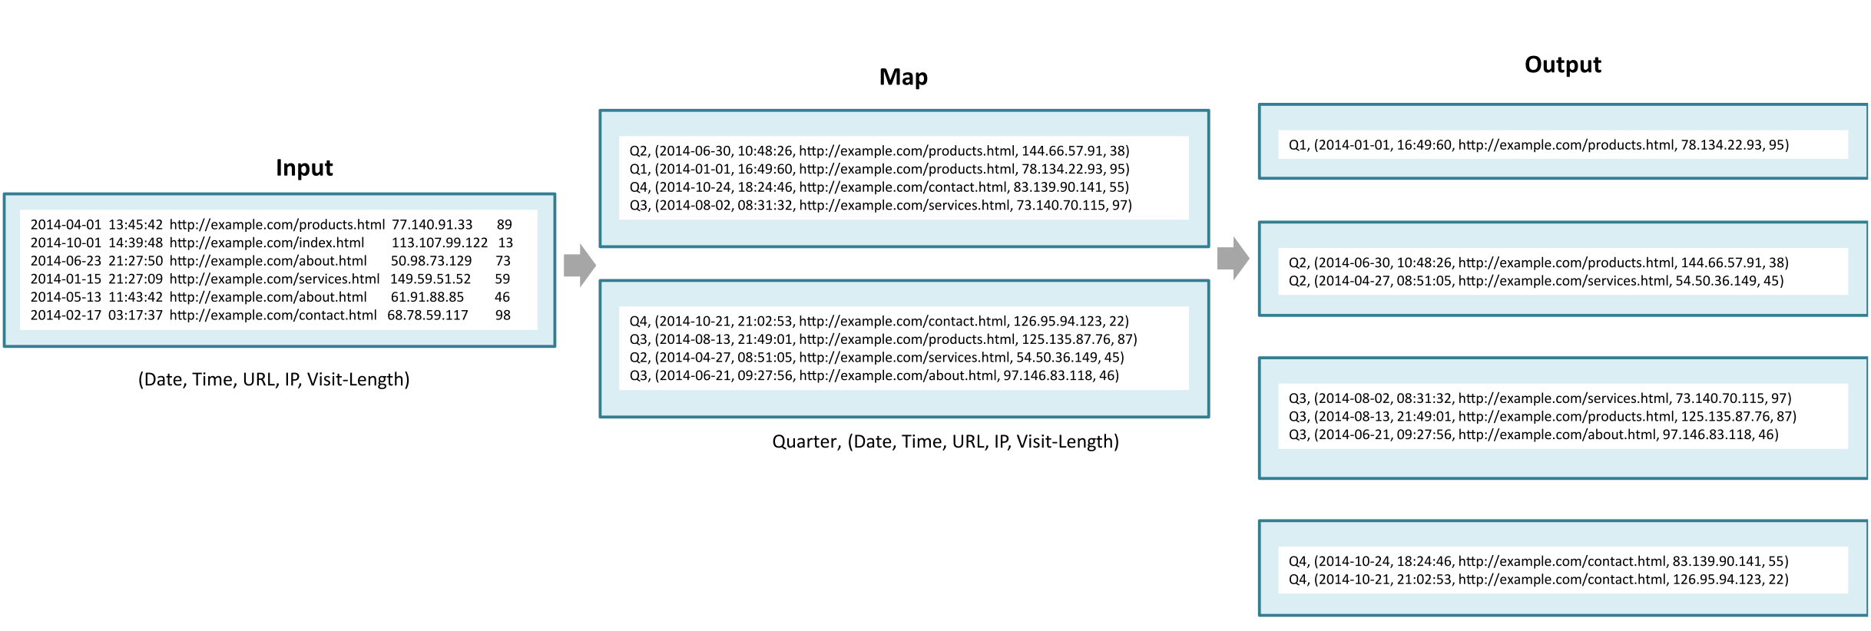
Binning
The Binning pattern is used to partition records into bins or categories.

Slide 90
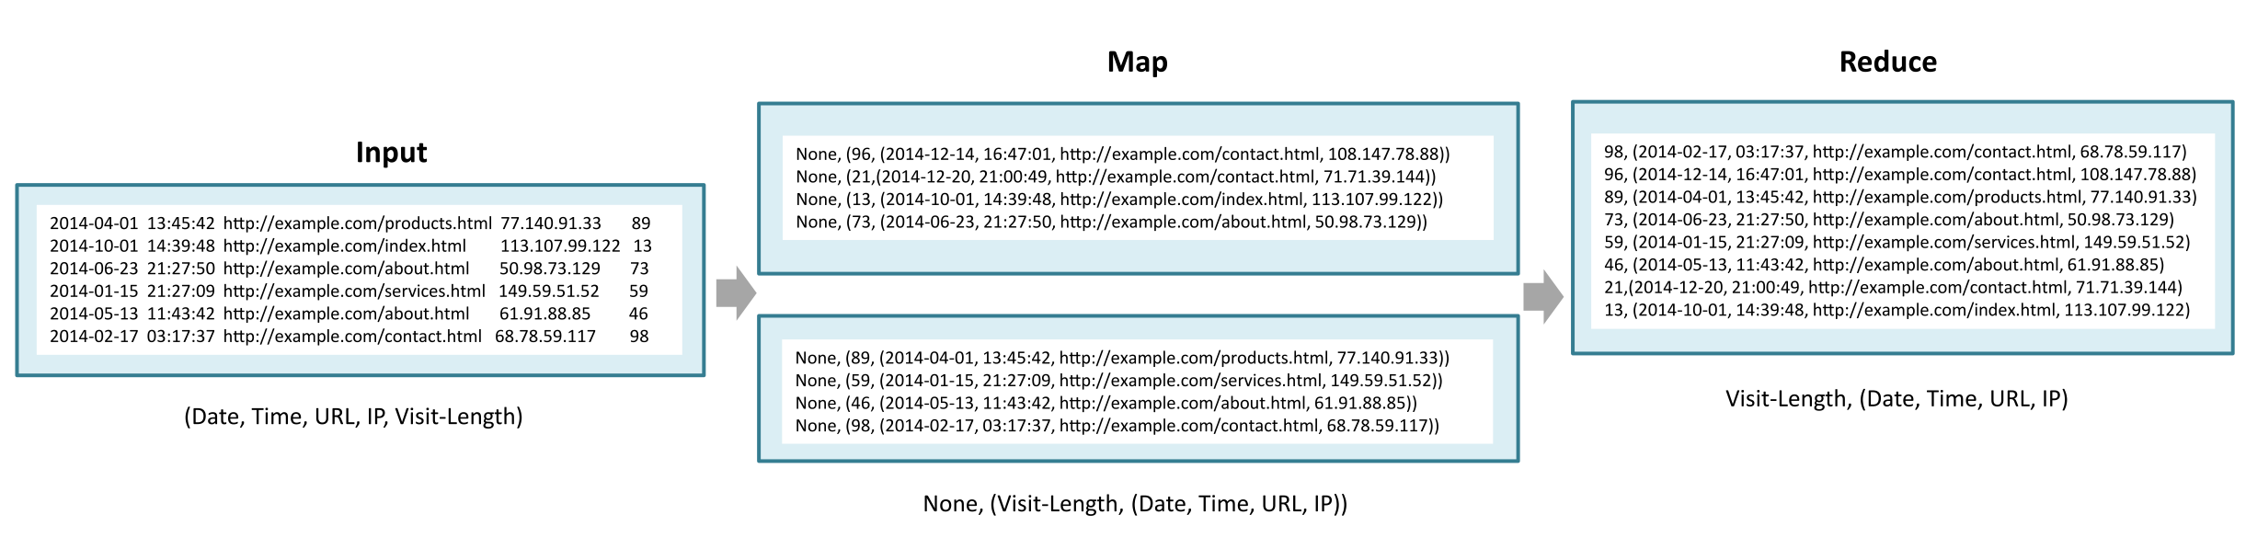
Sorting
The sorting pattern is used to sort the records based on a particular ﬁeld.

Slide 91
Big Data Batch Processing Tools

Slide 92
Pig
Pig is a high-level data processing language that makes it easy for developers to write data analysis scripts, which are translated into MapReduce programs by the Pig compiler.
Pig includes:
(1) a high-level language (called Pig Latin) for expressing data analysis programs and
(2) a compiler that produces sequences of MapReduce programs from the pig scripts.
Pig can be executed either in local mode or MapReduce mode.
In MapReduce mode, Pig can analyze data stored in HDFS.
Pig compiler translates the pig scripts into MapReduce programs which are executed in a Hadoop cluster.

Slide 93
Big Data Batch Processing Tools

Slide 94
Apache Oozie
Oozie is a workflow scheduler system that allows managing Hadoop jobs.
With Oozie, you can create workflows which are a collection of actions (such as MapReduce jobs) arranged as Direct Acyclic Graphs (DAG).
Control dependencies exist between the actions in a workflow.
An action is executed only when the preceding action is completed.
An Oozie workflow specifies a sequence of actions that need to be executed using an XML-based Process Definition Language called Hadoop Process Definition Language (hPDL).
Oozie supports various types of actions such as Hadoop MapReduce, Hadoop file system, Pig, Java, Email, Shell, Hive, Sqoop, SSH, and custom actions.

Slide 95
Big Data Batch Processing Tools

Slide 96
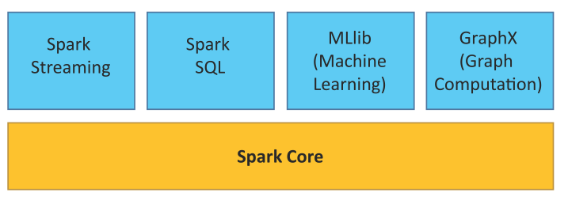
Spark
Apache Spark is an open source cluster computing framework for data analytics
Spark supports in-memory cluster computing and promises to be faster than Hadoop.
Spark allows real-time, batch and interactive queries and provides APIs for Scala, Java and Python languages.

Slide 97
Big Data Batch Processing Tools

Slide 98
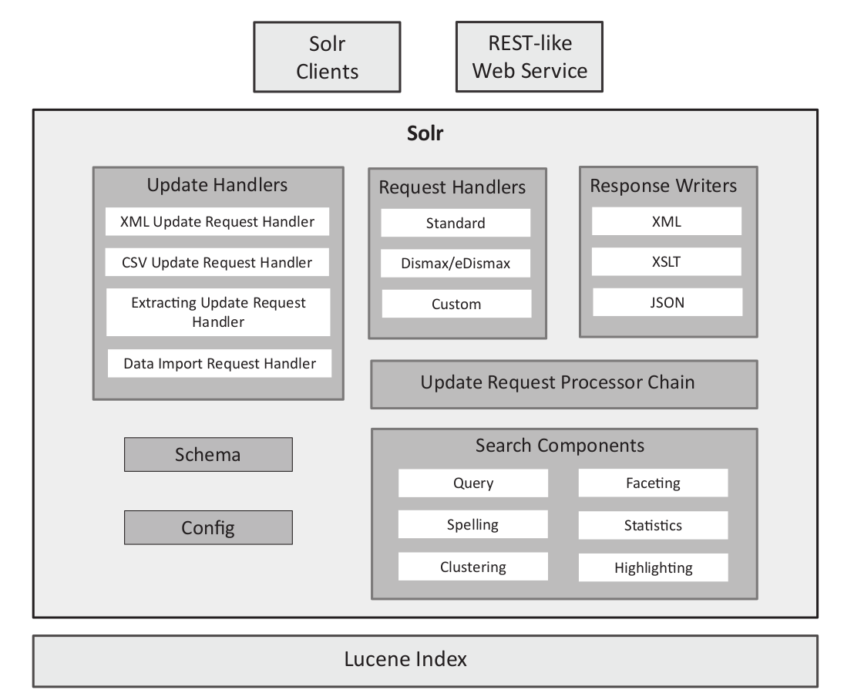
Apache Solr
Apache Solr is a scalable and open-source framework for searching data.
Solr is built on Apache Lucene, which is an open source library for indexing and search.
To enable searching of documents, Solr creates an index of the documents.
Solr can index documents in XML, JSON, CSV and binary formats.
Solr provides a REST-like web service that can be used for indexing and querying.

Slide 99
Big Data Batch Processing Tools

